Slide 1
Capabilities and Limitations
Overview
Examine the strengths of generative AI like generating text and augmenting human capabilities, along with limitations around reasoning, awareness, and biases. Learn techniques to mitigate weaknesses when deploying AI.
Learning Objectives
Explain the strengths and weaknesses of Generative AI.
Identify the types of practices that help mitigate some of the weaknesses.

Slide 2
Suggested Agenda (45 minutes)
0:00-0:02 Review Learning Objectives
0:02-0:10 Automation vs. Augmentation
0:10-0:20 Strengths and Weaknesses
0:20-0:40 Practice: Mitigating Limitations
0:40-0:45 Reflection
*these are estimates - timings will vary!

Slide 3
Teaching Guide:
Use the following quick tips for instructional guidance.
Title | What to Do
Learning Objective Slides | Pause to unpack the learning objectives and prime students for the lesson. This is a crucial step in the learning process and gives participants time to build context and activate any prior knowledge.
Solo Activities | For solo activities, you can choose to put people in group breakout rooms (to create the “table” group that they would be in in a physical setting) or allow students to work independently in the main session.
Group and Partner Discussions and Exercises (Remote) | Creating Breakout Rooms — Group and Partner Exercises Set up breakout rooms for pairs/groups. Broadcast directions and discussion questions to all breakout rooms. At the 60-seconds-left mark, broadcast a message to all rooms: “Start to wrap up your discussions. Rooms will close in one minute!” Move around from breakout room to breakout room to “walk around the classroom.”
Group and Partner Discussions and Exercises (In Person) | Facilitating Group and Partner Discussions and Exercises — Live Classroom Arrange the room prior to the session to create a conducive environment for group work. Provide clear, concise instructions verbally and on a handout or slide for the exercise, ensuring that all participants are aware of the goals and the time allocated. Circulate around the room to engage with groups Display a timer or announce when there is 1 min remaining Facilitate the sharing of group conclusions or discussion points with the whole class, ensuring that each group has a voice.

Slide 4
Capabilities and Limitations

Slide 5
LEARNING OBJECTIVES
Differentiate between automation and augmentation
Explain the strengths and weaknesses of Generative AI.
Identify the types of practices that help mitigate some of the weaknesses

Slide 6
Automation vs Augmentation
Notes:
We’re going to start out by digging deeper into two ways Gen AI can help us - automation versus augmentation.
This should then help us work out which business use cases are most appropriate.

Slide 7

Before discussing the capabilities and limitations of Large Language Models, we need to differentiate between the ways we can use them to impact our day-to-day tasks.
LLMs can be used to automate some things, and augment others.
💡What do we mean by automation and augmentation? Can you think of examples for each?
Type your response in the chat.

Slide 8

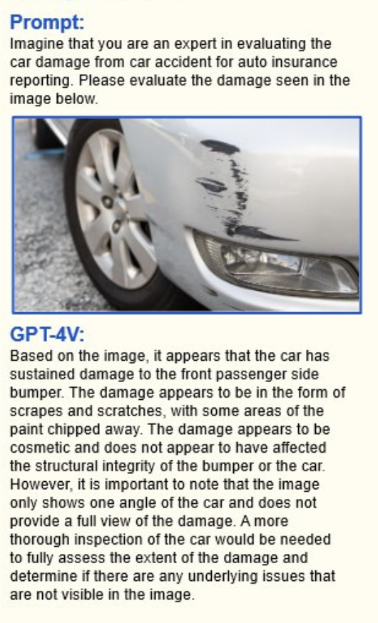
Automation vs. Augmentation
VS.
Image: “The Apartment” (1960), Directed by Billy Wilder. Retrieved from FilmGrab.
Image: https://arxiv.org/abs/2309.17421
Notes:
In the example on the left, the task of calculating insurance premiums has been replaced by mainframes, spreadsheets, code. This work has been automated.
On the right hand side, the present-day insurance agent can work with a multimodal tool like GPT-4V to write up a damage report based on a customer-submitted photo. This work has been augmented - it still needs to be checked by a critical human, but it will speed up the work significantly.

Slide 9
Automation or Augmentation
Automation
Augmentation
That
Routine tasks e.g. Filling out expense reports, scheduling meetings, timesheets
Repetitive tasks e.g. weekly reports, basic customer service, data entry
Notes:
Automation tasks are typically those that we can delegate to the AI, and in theory we can then productise those tasks and build the automated execution of them into our workflow.
This is something we’ll be looking at in more detail in a later module.
Typically though, they’ll only form part of a workflow.

Slide 10
Automation or Augmentation
Automation
That
Augmentation
Routine tasks e.g. Filling out expense reports, scheduling meetings, timesheets
Repetitive tasks e.g. weekly reports, basic customer service, data entry
Tasks requiring Critical Thinking e.g. performance reviews, crisis management, negotiating contracts
Complex problem-solving e.g. regulatory compliance, cybersecurity strategy, roadmapping
Notes:
Augmentation tasks are ones where we really won’t want to outsource our brain to the Generative AI, we’ll use it much more as sparring partner, or we’ll really need to interrogate it to help us with our thinking or our problem solving.
Augmentation tasks are what we’ll focus on in the first few modules.

Slide 11
Think About It: Automation vs. Augmentation 🤔
What are some other tasks that might benefit from augmentation?
Type your response in the chat.

Slide 12
Strengths and Weaknesses

Slide 13
Large Language Model Strengths
1
Text Generation
Generates well-written text
3
Flexible
Can be fine tuned for specific tasks
2
General Knowledge
“Knows” a lot about the world
4
Always On
Available for use 24/7
Notes:
PURPOSE: Understand the core strengths of large language models.
TALKING POINTS:
• Large language models are exceptional at generating coherent and contextually relevant text, simulating a human-like writing style.
• They possess a broad range of general knowledge, assimilating information from a vast corpus of data.
• These models are incredibly flexible, capable of being fine-tuned to perform specific tasks beyond generic text generation.
• They offer an "always-on" capability, providing services and interactions at any time without the need for breaks or downtime.
TEACHING TIPS:
• Highlight the importance of text generation by discussing how this can be applied in various real-world scenarios such as customer service, content creation, and coding.
• Use examples to show how general knowledge can be leveraged in AI to provide insights and answers across different domains.
• Emphasize the reliability and constant availability of these models, and how this can be beneficial for businesses that require 24/7 operations.

Slide 14
Large Language Model Weaknesses
1
Hallucinations
Fabricating facts or details
5
Poor at Basic Math
An inability to add up
2
A blind spot for recent events
Knowledge cut-off at e.g. 2021
6
Taking mental shortcuts
Over-reliance on training data
3
A lack of self-awareness
LLMs can’t train on themselves
7
Limited Memory
Or “context window”
4
Repetitive Tone
At least out of the box
8
Poor at unusual logic tasks
Due to a lack of prior exposure
Notes:
Here are some of the many limitations expressed in a different fashion. LLMs are getting better all the time, and some of these problems will disappear eventually.
But for now we need to know how to mitigate.
PURPOSE:
To point out the limitations of Large Language Models (LLMs) and foster an understanding of their operational boundaries.
TALKING POINTS
The issue of overconfidence is exacerbated by a technique that actually makes LLMs safe: Reinforcement Learning from Human Feedback (RLHF). We’ll explore this method in the next lesson.
We’ve already talked about how there’s a knowledge cut-off for recent events, but this also has an effect on tasks that require models to run code, like data analysis
This then has an impact on LLM’s self-knowledge - GPT-4 only knows about the existence of GPT-3!
Out-of-the box, Generative AI tools can struggle to write in different styles, which is why most AI-written text sounds the same (and can be relatively easy to detect).
We’re used to machines or computers having perfect mathematical ability, so it can be quite difficult to understand why LLMs are so poor at basic maths
LLMs can’t truly reason, and are prone to jumping to an answer without thinking it through
A limited context window means that we often have to explain the same thing over and over again - or that we have to turn to different models for very large text.
Because they’ve been trained on a wealth of examples of real-world situations, sometimes when a scenario differs, LLMs can fail to notice, and slip up
TEACHING TIPS
• Engage learners with real-world examples of each limitation to drive home the concepts.
• Prompt discussions on potential solutions or workarounds for these limitations.

Slide 15
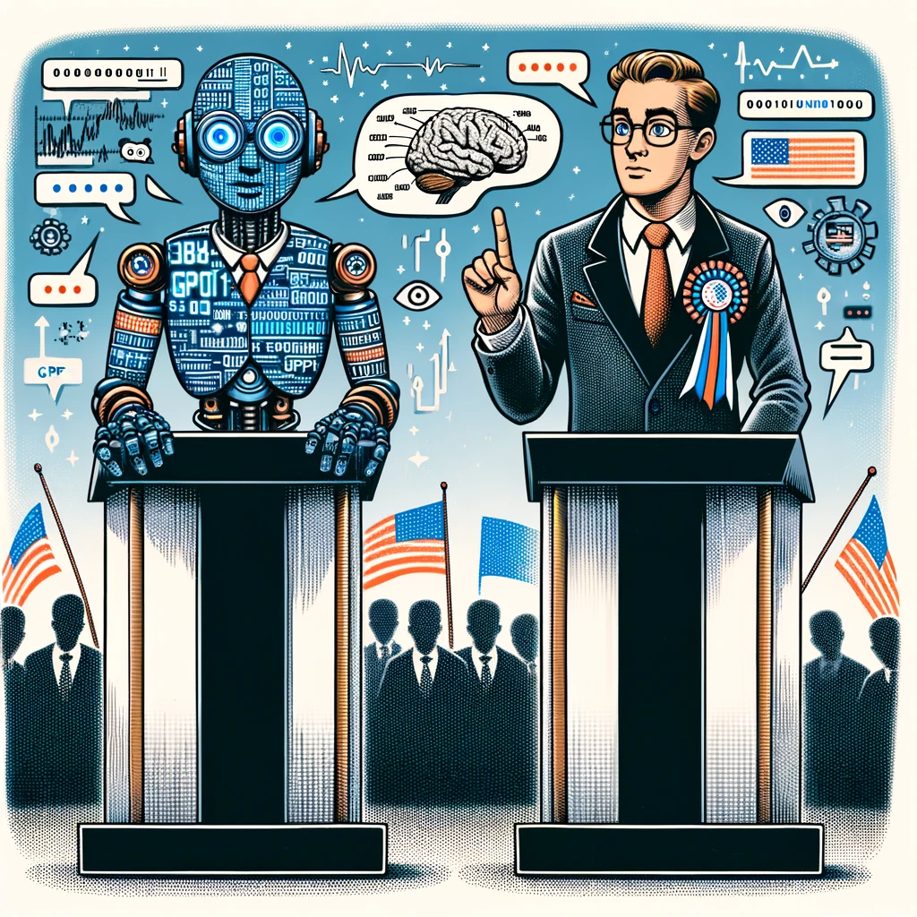
Sounds a bit like a politician?
1
Hallucinations
5
Poor at Basic Math
2
A blind spot for recent events
6
Taking mental shortcuts
3
7
Limited Memory
A lack of self-awareness
4
Repetitive Tone
8
Poor at unusual logic tasks
Notes:
Opportunity for a joke
Say: this non-partisan point - I hope we can all agree on this!

Slide 16
Large Language Model Mitigations
1
Hallucinations
Allow LLM to say “I don’t know”
5
Poor at Basic Math
Allow to run code, “take a breath”
2
A blind spot for recent events
Use web-connected LLM
6
Taking mental shortcuts
Tell the LLM it is prone to such biases
3
A lack of self-awareness
Use web-connected LLM
7
Limited Memory
Use a different model (e.g. Claude)
4
Repetitive Tone
Use Custom Instructions
8
Poor at unusual logic tasks
Ask to “take a breath”
Notes:
PURPOSE:
To introduce the idea that we may need to use extensions or plugins, that we need to keep our wits about us, and that writing effective prompts is incredibly important.
TALKING POINTS
Bizarrely, sometimes you simply need to give the LLM permission to say “I don’t know” - we’ll explore this in Writing Good Prompts
TEACHING TIPS
• Engage learners with real-world examples of each limitation to drive home the concepts.
• Prompt discussions on potential solutions or workarounds for these limitations.

Slide 17

Mitigating Limitations:
Poor Math and Poor Logic
Login to ChatGPT for this activity!

Slide 18
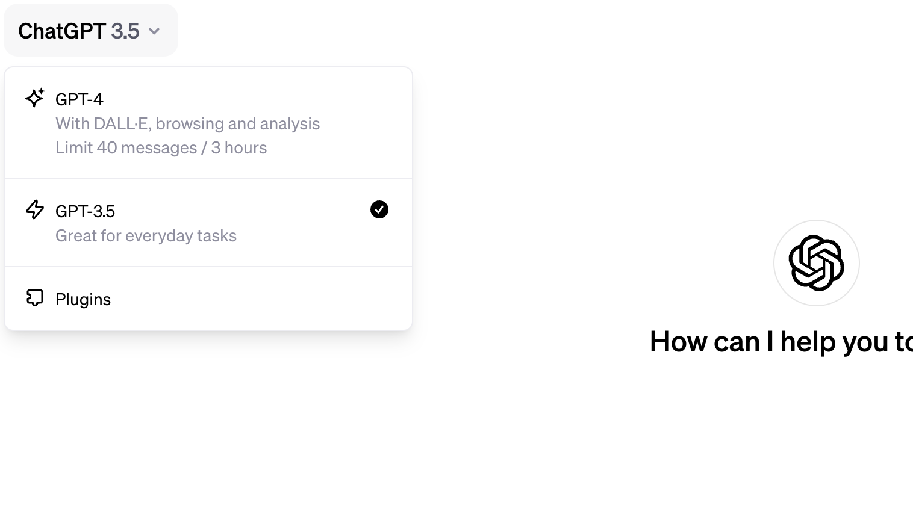
GPT-3.5
Switch over to GPT-3.5 for these practice activities!
Notes:
TEACHING TIPS: - give everyone 2-3 minutes to log in to chatgpt
- post the url for it in Zoom
- create a message in Zoom saying something like 'I have logged in to ChatGPT' and get people to add a thumbs up emoji when they've done it

Slide 19
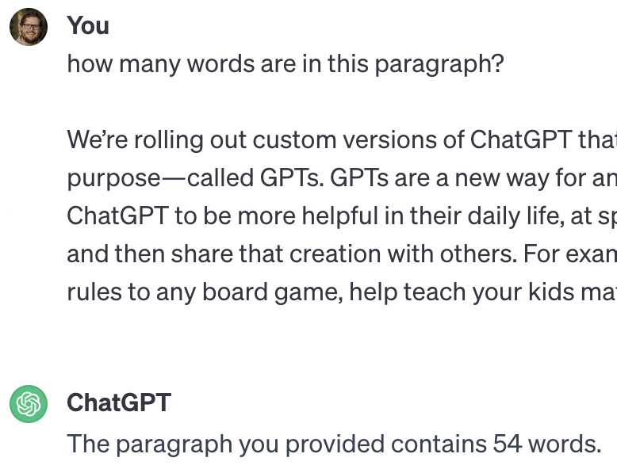
Mitigating Poor Maths: Word Count
5 Minutes
First ask GPT-3.5 Default to count the number of words in a paragraph. Ensure it’s making a mistake!
Instructions:
GPT-3.5
Description
1
Try using GPT-3.5 to complete the task correctly.
2
How can you prompt it to do so? Start new chats as needed.
Notes:
SAMPLE PARAGRAPH - Copy-paste this into the meeting chat for others to use: We’re rolling out custom versions of ChatGPT that you can create for a specific purpose—called GPTs. GPTs are a new way for anyone to create a tailored version of ChatGPT to be more helpful in their daily life, at specific tasks, at work, or at home—and then share that creation with others. For example, GPTs can help you learn the rules to any board game, help teach your kids math, or design stickers.
Because ChatGPT is just predicting the next word - it is making a prediction of roughly how many words would be contained in the kind of paragraph that would contain such words. It might get close, but it doesn’t have the ability to calculate or count out of the box.
How could we get GPT-3.5 to count the exact number of words?
(One way is to get ChatGPT 3.5 to number each word, and not give it’s answer until it has finished doing this)

Slide 20
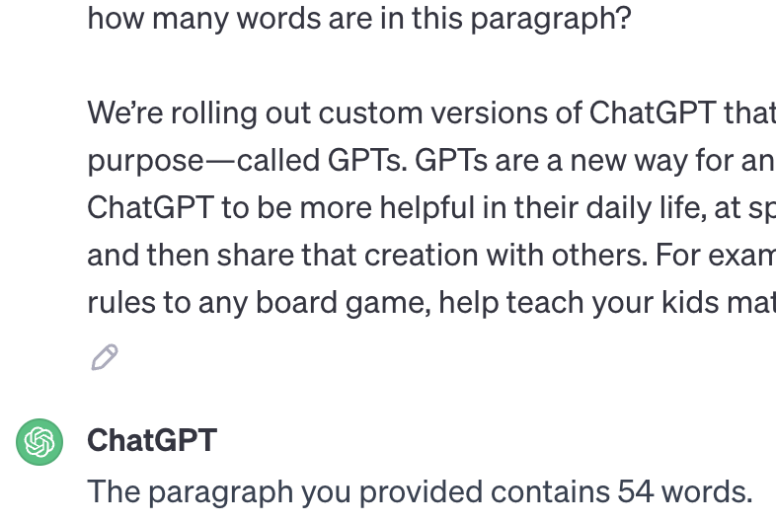
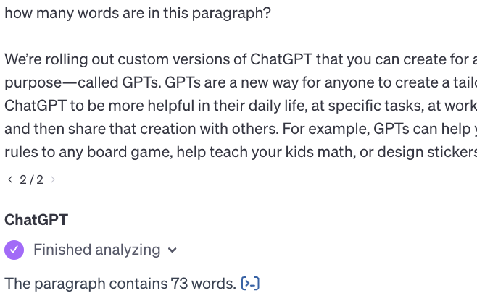
Mitigating Poor Maths: GPT-3.5 vs GPT-4
GPT-3.5
GPT-4
VS.
Notes:
As of the November 2023 updates, GPT-4 is more likely to use Python to count words when asked!

Slide 21
Mitigating Poor Logic
Prompt to use:
5 Minutes
Make sure to run this exercise on a fresh conversation each time, no Custom Instructions.
Instructions:
“Sally has 3 brothers. Each brother has 2 sisters. How many sisters does Sally have?”
1
Run the prompt to use on a fresh conversation. What does the LLM answer?
2
Try to use a different prompt on a fresh conversation to get the right answer.
3
Bonus: use custom instructions with the original prompt to get the right answer.
Notes:
SOLO ACTIVITY
Go through the instructions - provide a quick demo if students are confused.
Students complete activity. Monitor their progress and answer questions throughout.
Debrief on next slide

Slide 22
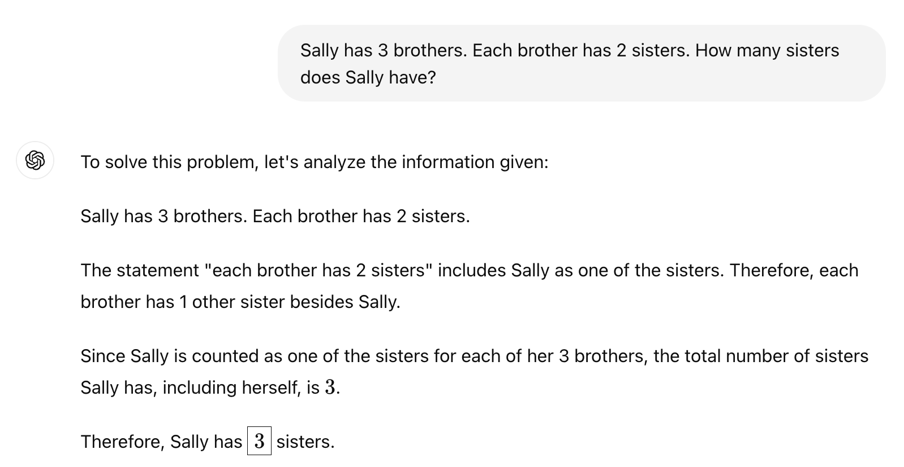
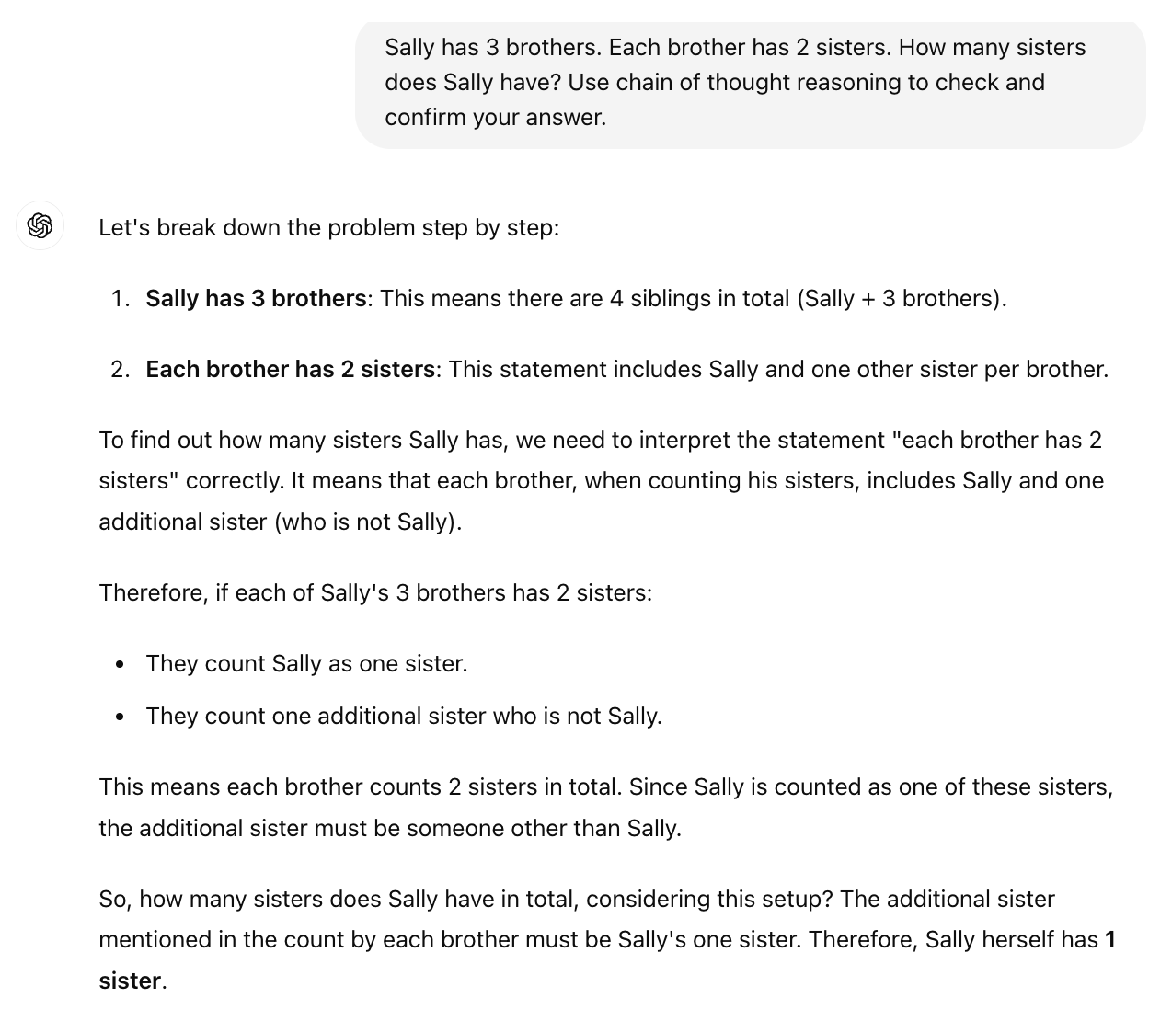
Mitigating Poor Logic: Chain of Thought Reasoning
Simple Prompt
Better Prompt
VS.
Notes:
NOTE: Responses here will vary when students try this on their own - especially when using GPT-3.5. This may end up being a great time to highlight the inconsistencies and limitations of LLMs. Especially earlier versions like GPT-3.5

Slide 23
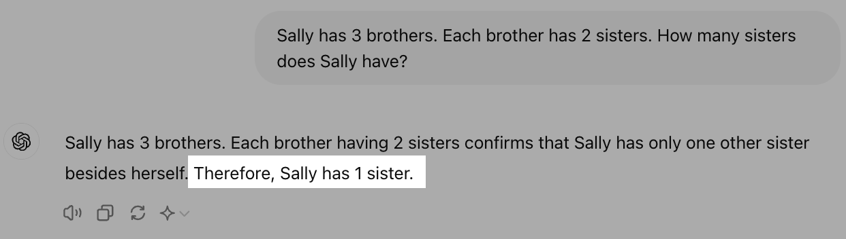
Models Frequently Improve
Despite rumors to the contrary, models like GPT-4 continue to be fine-tuned.
This means that some prompts we use to demonstrate limitations of LLMs may no longer produce the same result.
Notes:
- It's important to remember models like GPT-4 continue to be refined over time.
- Prompts that previously exposed limitations may not work anymore as capabilities improve.
- You can check your ChatGPT version number to track changes.
- Don't be afraid to experiment with different prompts for the best results.

Slide 24
Capabilities and limitations

Slide 25
Reflection: Capabilities and limitations
1
Could mitigating for some limitations introduce other biases? If so, how?
2
Which tools or techniques from this lesson do you want to practice more extensively?
Notes:
- Ask participants to reflect on their own, either in their own heads or by jotting down notes
- If they would like to share their reflections, let them know they can do so in the Zoom chat

